Slide 1
Seattle Crime Data Analysis
Submitted by:
Jithin Raj MK Mallikarjun Esnapur

Slide 2
Contents:
Objective
Dataset Overview
Pre-Processing
Data Exploration
Inference
Conclusion

Slide 3
Objective
Analyze the Seattle Crime Data to understand the Crime Chronology have insights on the historical Crime data and enforce better Patrolling Policies for future Security.

Slide 4
Dataset Overview
Seattle Government maintains a Open Data Program for increasing the quality of life of residents; increasing transparency, and accountability.
This Dataset has 17 Columns, 1.1K Records which includes the Category of Offence, Location, Reported Date and Offence committed Date.
SPD-Crime-Data-2008-Present

Slide 5
Pre Processing
We checked for Null Values
Looked for Insignificant Columns for our Analysis
100_block_address, Offence End date.

Slide 6
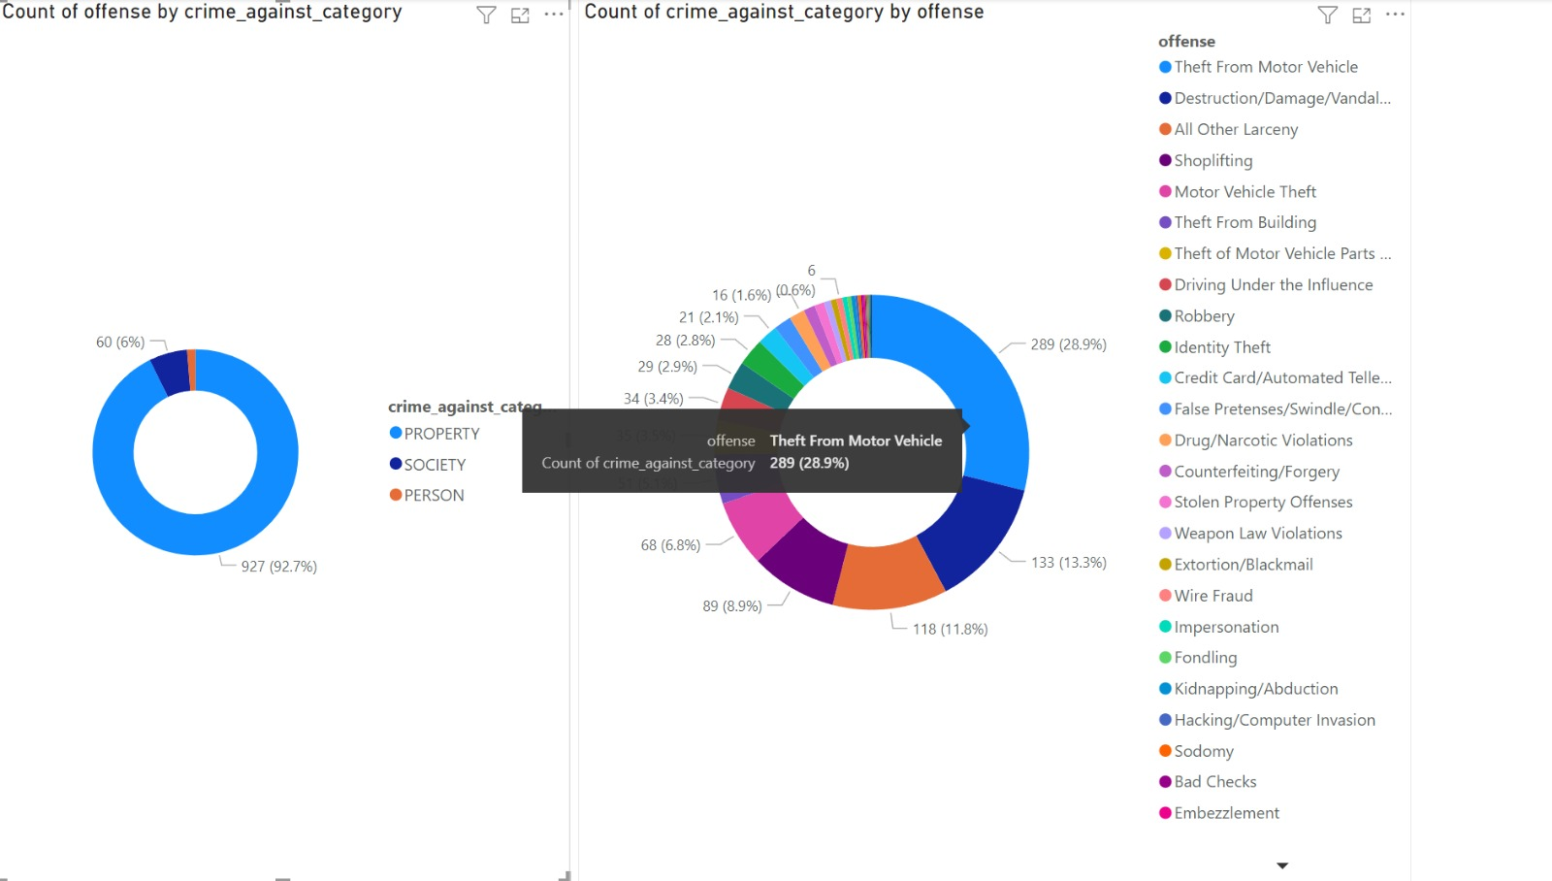
Data Exploration
Categorized by Crime Categories and Offence.

Slide 7
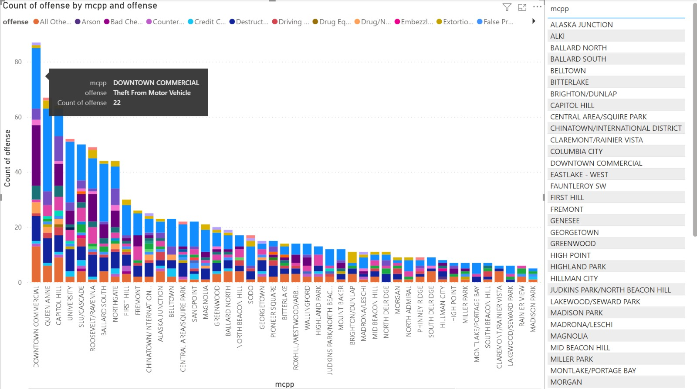
Data Exploration

Slide 8
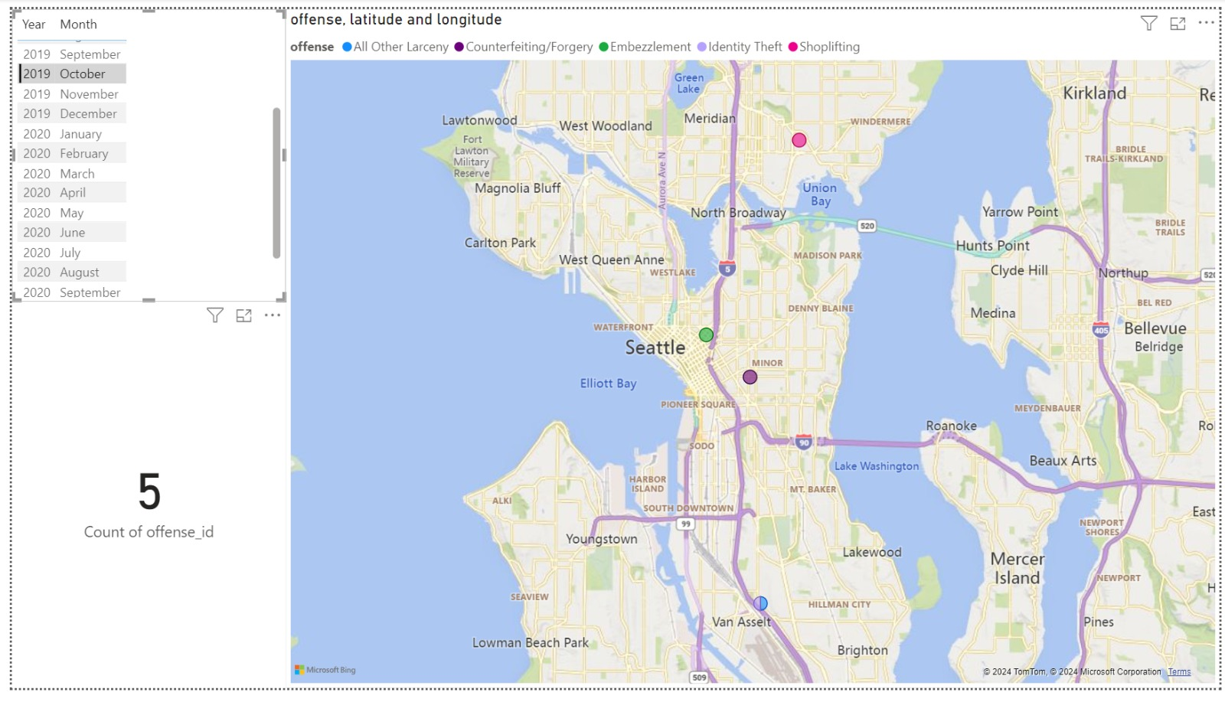
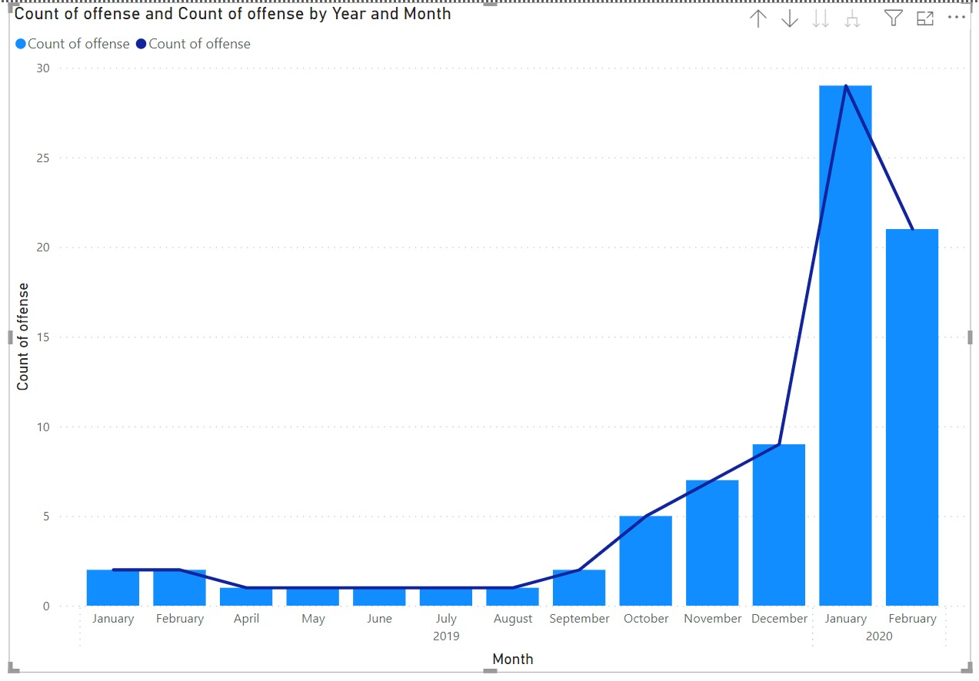
Data Exploration

Slide 9
Inference
Most Crimes were committed against Property - Parent Category
Theft from Motor Vehicles are contributing to 28.9% of Crimes
We could observe the trend of Crimes in Downtown is High followed by Queen Anne, University.
With the inception of Covid -19, the crimes reported were spiked and later subsided.

Slide 10
Conclusion
As most of the Crimes are against Property, citizens should avoid leaving their Motor Vehicles unattended for longer periods.
Crimes against property include, Theft from Motor Vehicles, Shoplifting, Property Vandalism/Property Damage.
In the locations highlighted, more robust Patrolling Policies should be enforced.

